Slide 1


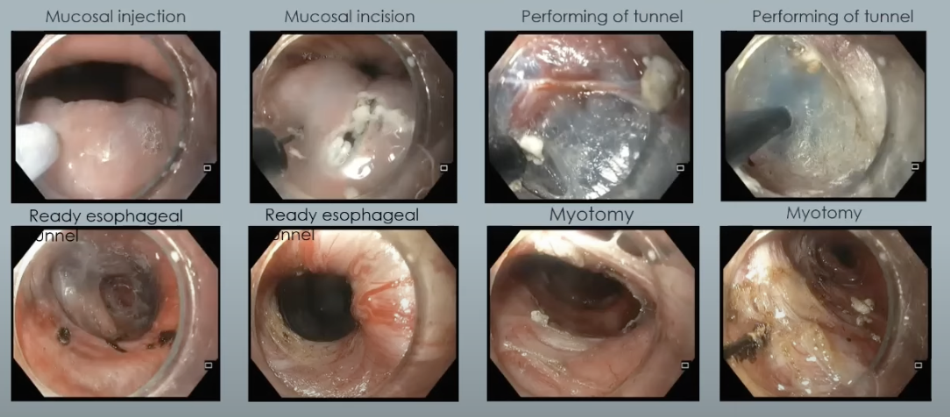
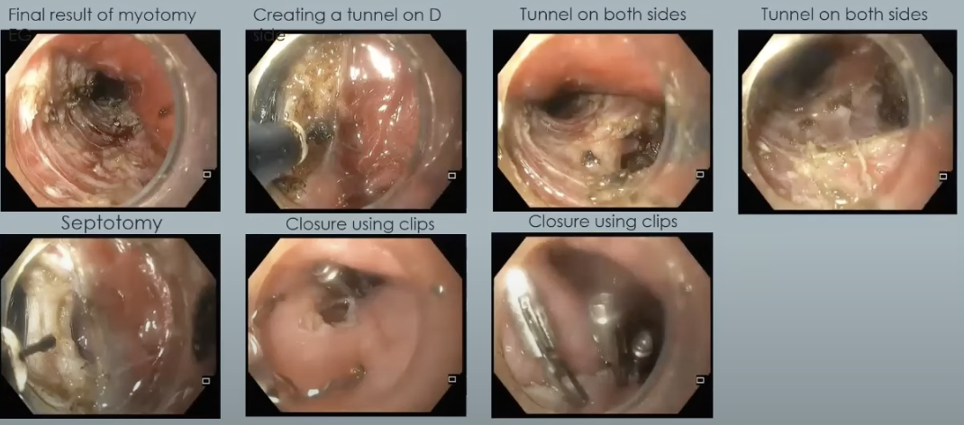
Building a Remote Gastrointestinal Care
Network in a Region of Global Conflict
Renata Lerer¹; Junghyun Lim¹; Viktor Pashynskyi²; Maisie Savchenko-Fullerton³; Kierstyn Claycomb¹; Lillias H Maguire¹;
David E Kaplan¹; Patrick J Brennan¹; James D. Lewis¹; Yaroslav Radoga²; Gregory G. Ginsberg¹
¹Univeristy of Pennsylvania, Philadelphia, PA, United States; ²Vinnytsia M.I. Pyrohov Regional Clinical Hospital, Vinnytsia, Ukraine; ³BARVY, Vinnytsia, Ukraine
BACKGROUND
RESULTS
RESULTS
During times of conflict, there is an increased need for medical care for both the military and civilians alike.
The war in Ukraine resulted in significant practice changes to regional medical centers as they provide care to internally displaced persons and with limited resources.
The aim of this initiative was to improve the care of gastrointestinal (GI) diseases and patient outcomes in a resource constricted region in the context of the conflict.
The PMUKP’s video conferences included:
  Consultation via 63 case presentations with recorded video, spanning a broad range of GI and endoscopic management challenges (Figure 1).
  Didactic teaching via 11 topic specific presentations by GI fellows under the guidance of GI subspecialists and surgeons.
  1 live case transmission demonstration from the United States (per oral endoscopic myotomy [POEM] for achalasia) (Figure 2).
  Real-time remote proctoring of 2 endoscopic procedures performed in Ukraine (POEM for treatment of Zenker’s diverticulum [Z-POEM] and POEM with diverticulectomy [D-POEM]).
The Ukraine physicians reported that online consultation with Penn colleagues enriched their professional knowledge as well as significantly improved the quality of medical care for their patients in Ukraine, by improving access to high-quality diagnostic and treatment methods.
In such challenging times for Ukraine, this collaboration and support enhanced the efficiency and effectiveness of their medical practice.
METHODS
Figure 1: Categorization of remote GI consultation cases
Under the Penn Global Medicine’s Penn-Ukraine Initiative and the Ukrainian non-governmental organization, Barvy, we partnered with the National Pirogov Memorial Medical University and Vinnytsia Regional Pirogov Clinical Hospital in Vinnytsia, Ukraine to establish the Penn Medicine–Ukraine Virtual GI Consultation Program (PMUKP).
The PMUKP provides consultation in medical and procedural management aimed to improve the care of patients with GI diseases and ultimately improve their outcomes and provide relief in resource allocation.
The PMUKP utilized bi-weekly video conferencing from 8/1/2022 to the present for case management discussions, didactic presentations, live case demonstrations, and real-time remote proctoring of endoscopic procedures.
CONCLUSION
Video remote consultation during a period of conflict can overcome barriers to access training through usual continuing medical education venues.
Remote live proctoring was essential to introduction of new techniques.
Similar methods could be applied to train endoscopists in other resource limited environments to provide state-of-the-art care.
Figure 2: Endoscopic Images of D-POEM

